Slide 1
EXTERNAL SYSTEM BUS ARCHITECTURE
GROUP 4
MEMBERS:
JOEL KANYI
KIMANZI LOICE
JERIMIAH AKUNGA
WELDON MUTAI
FRANCIS MUTUA
MIKE BOTA

Slide 2
What is a bus?
A bus is a communication system that transfers data between components inside a computer or between computers
Bus is a group of conducting wires which carries information,
Types of Buses
Data bus
Address bus
Control bus

Slide 3
Address bus –
It is a group of conducting wires which carries address only. Address bus is unidirectional because data flow in one direction, from microprocessor to memory or from microprocessor to Input/output devices (That is, Out of Microprocessor).Length of Address Bus of 8085 microprocessor is 16 Bit (That is, Four Hexadecimal Digits), ranging from 0000 H to FFFF H, (H denotes Hexadecimal). The microprocessor 8085 can transfer maximum 16 bit address which means it can address 65, 536 different memory location.
The Length of the address bus determines the amount of memory a system can address. Such as a system with a 32-bit address bus can address 2^32 memory locations. If each memory location holds one byte, the addressable memory space is 4 GB. However, the actual amount of memory that can be accessed is usually much less than this theoretical limit due to chipset and motherboard limitations.

Slide 4
Data bus –
It is a group of conducting wires which carries Data only. Data bus is bidirectional because data flow in both directions, from microprocessor to memory or Input/Output devices and from memory or Input/Output devices to microprocessor. Length of Data Bus of 8085 microprocessor is 8 Bit (That is, two Hexadecimal Digits), ranging from 00 H to FF H. (H denotes Hexadecimal).
When it is write operation, the processor will put the data (to be written) on the data bus, when it is read operation, the memory controller will get the data from specific memory block and put it into the data bus.
The width of the data bus is directly related to the largest number that the bus can carry, such as an 8 bit bus can represent 2 to the power of 8 unique values, this equates to the number 0 to 255.A 16 bit bus can carry 0 to 65535.

Slide 5
Control bus –
It is a group of conducting wires, which is used to generate timing and control signals to control all the associated peripherals, microprocessor uses control bus to process data, that is what to do with selected memory location. Some control signals are:
Memory read
Memory write
I/O read
I/O Write
Opcode fetch
If one line of control bus may be the read/write line. If the wire is low (no electricity flowing) then the memory is read, if the wire is high (electricity is flowing) then the memory is written.

Slide 6
Bus organization of 8085 microprocessor
All the peripherals are connected to microprocessor through Bus.
The following diagram represents bus organization system of 8085 Microprocessor.

Slide 7
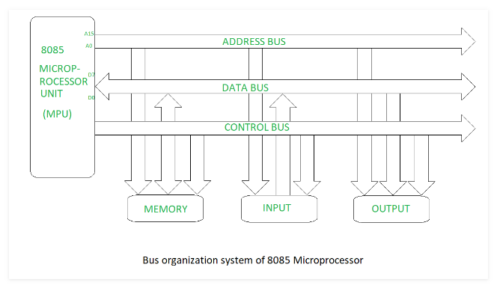

Slide 8
EXTERNAL SYSTEM BUS ARCHITECTURE
It is a 16 bit processor with 40 pins.
It has 20 address pins and out of which 16 are used as data pins.
This concept of using same pins for both address and data is called Multiplexing. It has 16 control signals.
It can access a memory of 1 MB.
It has 14 registers which are 16 bits wide.
There are a set of arithmetic registers, set of pointers(Base and Index registers),set of segment registers.
It has program status word(PSW) or Flag register and a instruction pointer.

Slide 9
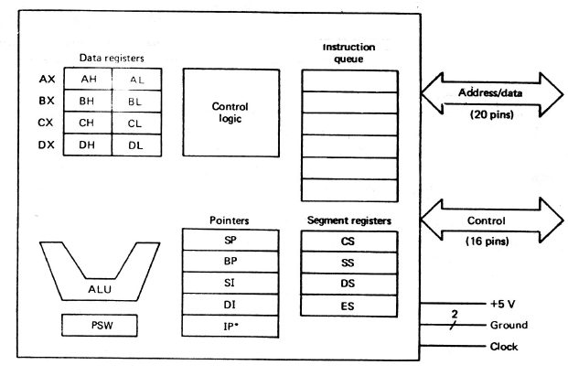

Slide 10
Architecture of 8086
EXECUTION UNIT (EU) and BUS INTERFACE UNIT (BIU)
8086 consist of two processors called EU and BIU. Two Processors can work in parallel. This improves
speed of execution. BIU fetches instruction and place them in instruction queue.
Execution unit decodes and execute instruction. When EU is executing an instruction BIU can fetch the
next instruction.
The diagram below depicts the architecture of a 8086 Microprocessor −

Slide 11
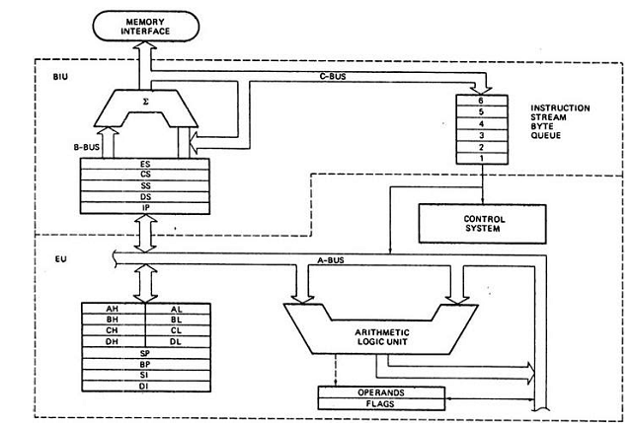

Slide 12
THE END
THANK YOU...

